Slide 1
Brain Age Predictor Replication Dataset
Skylar Wurster

Slide 2
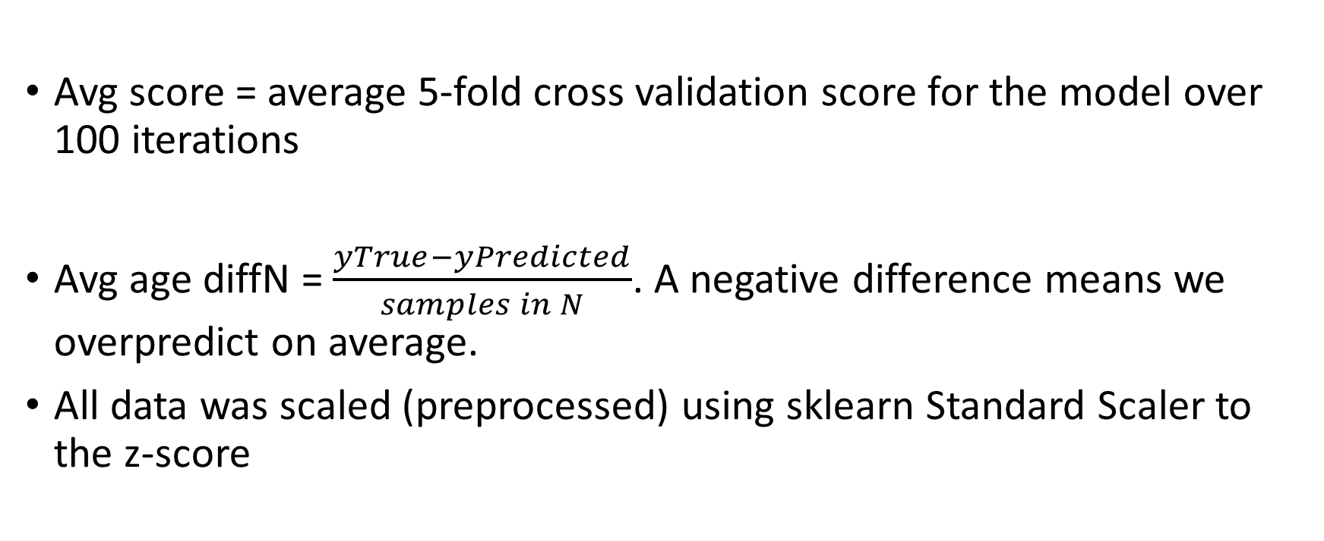
Background and important information
Avg score = average 5-fold cross validation score for the model over 100 iterations
Avg age diffN = $\frac{yTrue−yPredicted}{samples in N}$. A negative difference means we overpredict on average.
All data was scaled (preprocessed) using sklearn Standard Scaler to the z-score

Slide 3
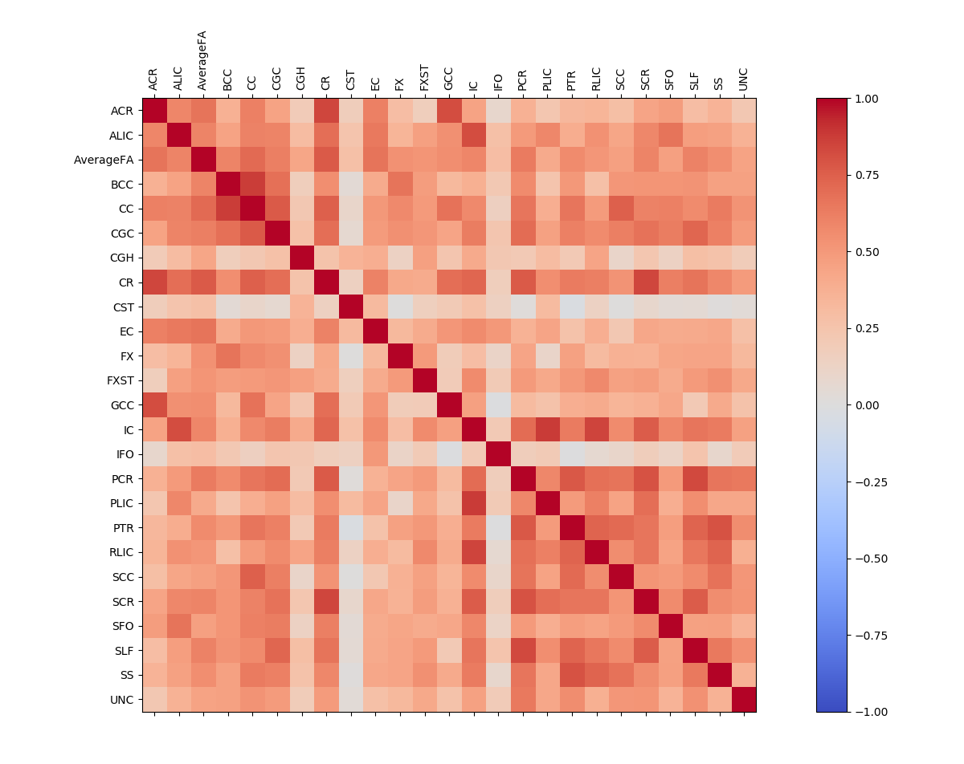
Multicollinearity in DTI dataset

Slide 4
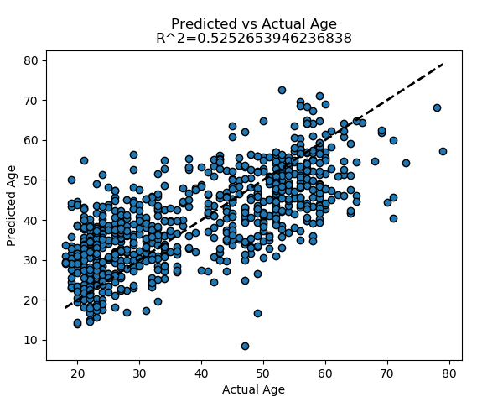
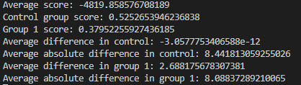
Linear Regression

Slide 5
SVM Regressor – RBF Kernel
Gamma=‘scale’
C=50

Slide 6
RidgeCV

Slide 7
Lasso

Slide 8
ElasticNetCV

Slide 9
BayesianRidge

Slide 10
Perceptron(Classifier)
Here, score is simply the accuracy of the classifier

